Slide 1
19159 – TrainESEE v.2.
Training trainers in East and Southeastern Europe
Presenter: UMG “St. Ivan Rilski” – Sofia
Contact persons for UMG:
Stefka Pristavova
Katerina Nikolova
Borislava Galabova
Evgenia Alexandrova

Slide 2
ABOUT TrainESEE v.2
TrainESEE v.2 is a capacity building project targeted at the six universities of the East and South Eastern Europe, with a focus on improving specific generic skills, in line with the curricula insufficiencies identified through the implementation of the EE S – Train ESEE pilot (2017-2018).
The duration of the project is 2 years, during which four training modules will be developed, implemented and prepared as acceleration programmes:
Teaching methodology;
Project development and management;
Innovation and entrepreneurial module;
Science to Business module.
Acceleration programmes are planned to last continuously for the minimum of 3 years after the implementation, increasing the percentage of the trained academic staff to >50% at each of the “Training” universities.

Slide 3
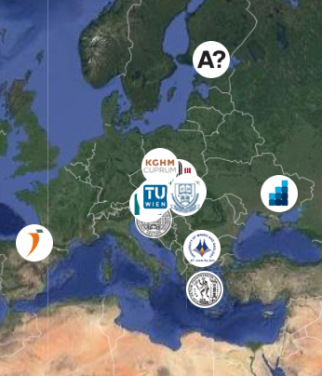
Project partners
TrainESEE v.2 gathers 12 partners from 10 different countries, all determined to improve and upgrade the education system in the raw materials sector. The Regional Innovation Scheme (RIS) activity is integrating 10 KIC (Knowledge and Innovation Community) partners from 3 collocation centers, 3 EIT HUB-s, 2 ESEE task partner universities and potentially 4 KIC ESEE (East & South-East Europe) universities, having low to medium level of activation, contributing to an overall de-siloing of the ESEE education community.
UNIZG-RGNF - Lead Partner
Aalto-Korkeakoulusaatio
AGH University of Science and Technology
Dnipro University of Technology
Fundación Tecnalia Research & Innovation
KGHM Cuprum sp. z o.o.
Montanuniversität Leoben
National Technical University of Athens
Technical University of Kosice
Technische Universitaet Wien
University of Mining and Geology “St. Ivan Rilski”
University of Miskolc

Slide 4
SWOT Analyses University of Mining and Geology “St. Ivan Rilski” – Sofia (Faculty of Mining Technology, Faculty of Geology and Exploration, Faculty of Mining Electromechanics, Kardzhali branch)
Responsible person for UMG - Evgenia Alexandrova, Assoc. prof., PhD
Status – completed task
development and application of appropriate criteria
questionnaires – academic staff of UMG
self-analysis of the development and activities of UMG “St. Ivan Rilski”
During the first four months of 2020, strengths, weaknesses, opportunities, and threats to the education systems of the six participating universities were carefully examined. The process showed that many of the partners share similar problems, but many important differences stemming from the institutional and organizational setup of the individual organizations and countries have also been identified. After the SWOT verification, intensive work was done on drafting the activities to be included in the future modules.

Slide 5
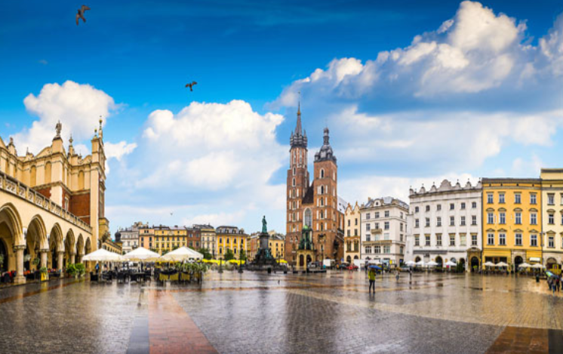
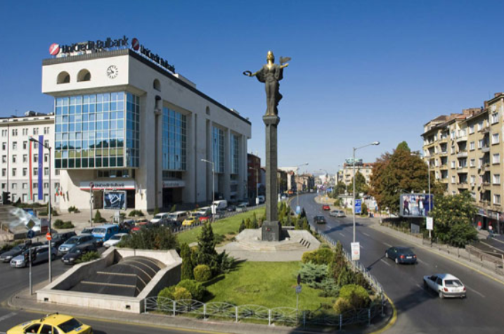
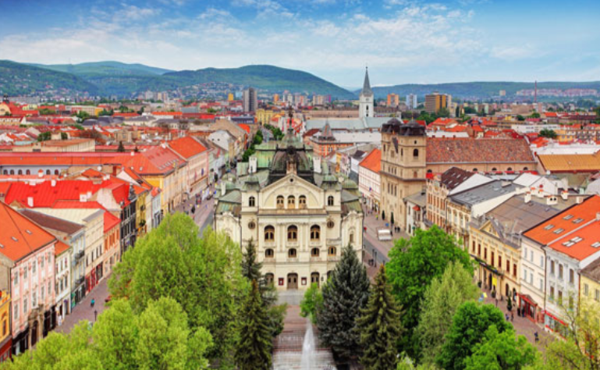
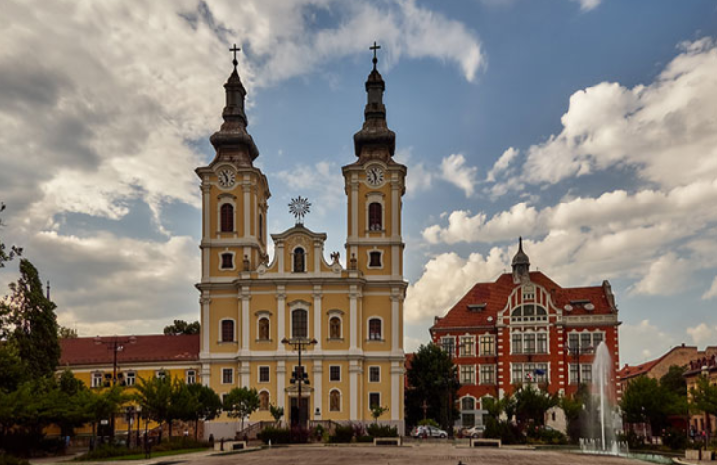
Workshops in 2021
5 days duration of each one. The registrations will open in November 2020.
Krakow (PL)
3/2021
Sofia (BG)
5/2021
Košice (SK)
09/2021
Miskolc (HU)
11/2021

